Slide 1


Bank of Baroda Hackathon - 2022
Technology Partner
Your Team Name : ZerOne
Your team bio :Sriram
Date :11-08-2022

Slide 2
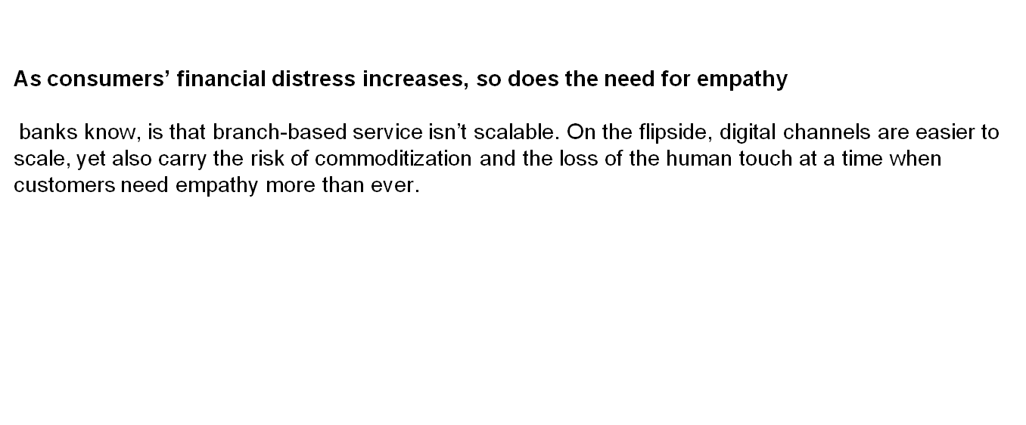
Problem Statement: Sentiments of customers

Slide 3
The impact of COVID-19 for banks will be on credit management. As government relief and stimulus programs start to taper down, banks will be called upon to help more customers under financial strain.
banks are very confident that they can sense customers’ emotional outlook about their financial situation without asking them directly. Few banks have the awareness and sensitivity they need to detect the challenges their customers face and offer proactive help.

Slide 4
Solution
Empathetic Banking Leaders resolve this tension through their ability to gather and use data insights to engage with their customers. Rather than forcing customers through a particular touch point, they offer customers channel choices based on their emotional state and financial need.
They constantly collect data that helps them anticipate the assistance a customer might require. And they do so in a consistent tone of voice across all channels, with messaging tailored to the customer’s emotional profile

Slide 5
AzurePing
AzurePing is the first entry in this list of azure development tools that is an effective productivity tool.
It is a free monitoring utility extension that runs as a local Windows Service.
AzurePing helps in maintaining tabs for Azure Storage resources or Azure-hosted databases.

Slide 6
Any Supporting Functional Documents
The growing maturity of today’s artificial intelligence and analytics solutions, paired with banking customers’ growing willingness to use digital channels even for complex interactions, offers leaders the opportunity to not only offer more personalized banking services and experiences to each customer, but to do so at scale.

Slide 7
Today we are in busy world and work load arises day by day .
The Customer not like to spend much time regarding loan apply .
My plan is to satisfy the Customer needs support to quick buy the Products Immediately at the moment. For instance Customer is in vacation time with his family In that mean time he likes to visit mall .
A product which he like most is get attracted by him. He likes to buy but he have no money ,in that situation .
The customer use Bank app by upload an image of the product and get bank support for immediate approval to proceed. At once the customer will become happy.

Slide 8
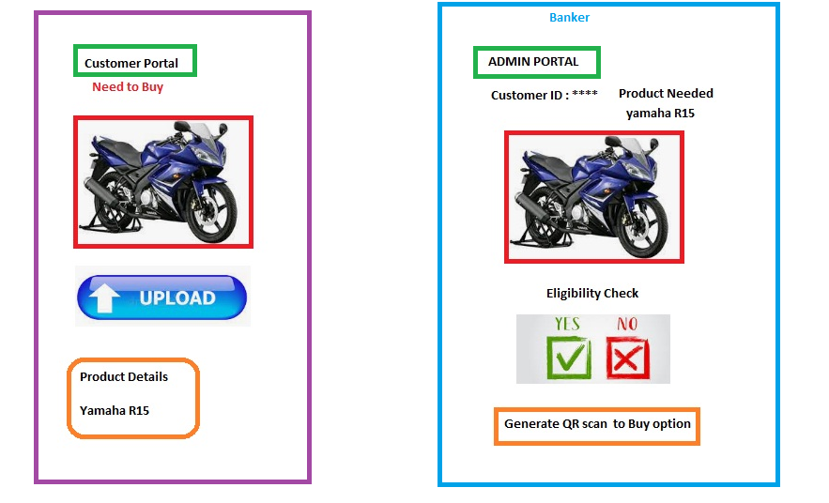

Slide 9
Thank You
S.SRIRAM

